Slide 1
Conditional Statements

Slide 2
Conditional Operators
< , > , <= , >= These work like Math!
Note that the “Equals” is after the Greater than or Less than
== Equals
!= Not Equals

Slide 3
If Statement
We use an if statement when we only want to run a piece of code when something is true.
if (1 == 1)
{
Run some piece of code between the brackets
}

Slide 4
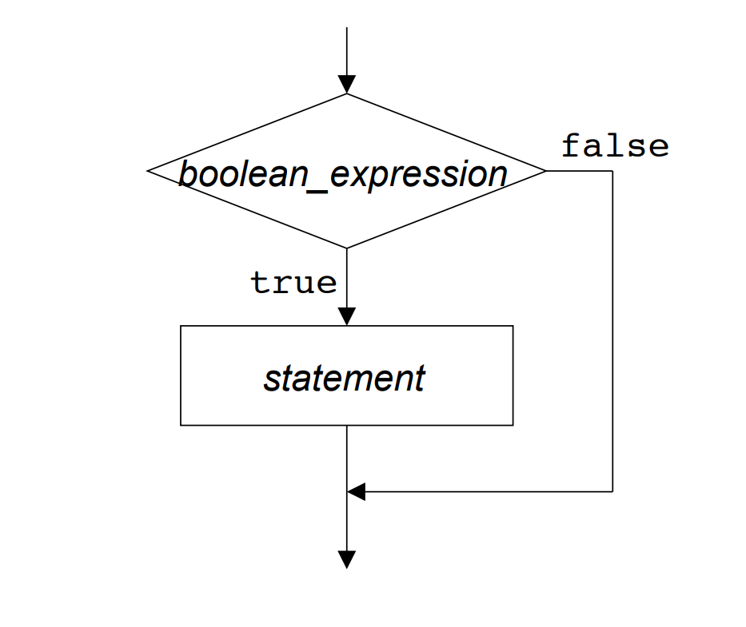
if Flowchart

Slide 5
Example
int age = 17;
if (age > 16)
{
Console.WriteLine("You can drive");
}
Notes:
Will anything be written to the console?

Slide 6
Else statement
When we want a different piece of code to run when a statement is false, we place it in an else statement
if (boolean) { // statement1
} else { // statement2
}

Slide 7
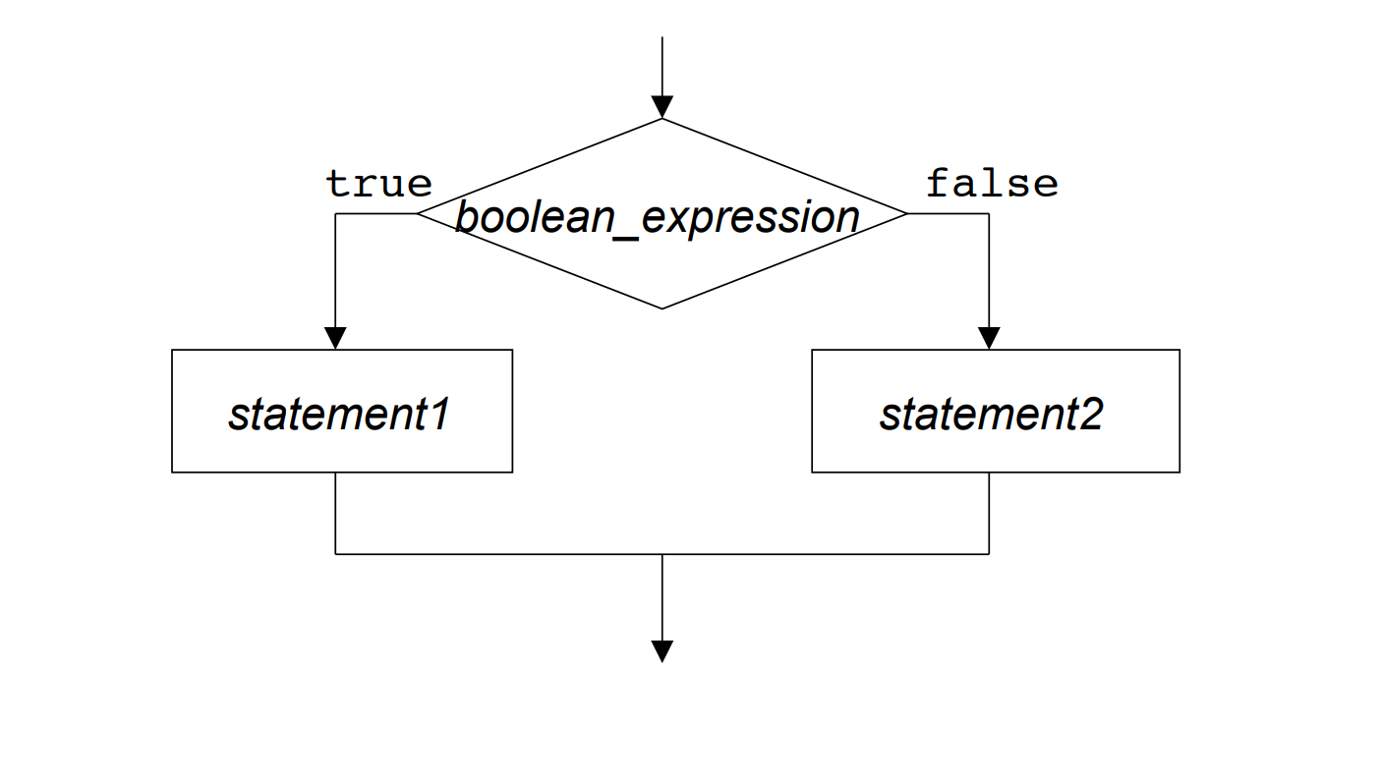
else Flowchart

Slide 8
Example
bool loggedIn = false;
if (loggedIn)
{
Console.WriteLine("Info...");
}
else
{
Console.WriteLine("Please Log In");
}
Notes:
What will be written to the console?

Slide 9
Else If
Sometimes a program requires multiple conditions, and can respond in more than two ways
For example, depending on the time of day, a program might greet the user in three different ways

Slide 10
Example
if (timeOfDay < 10) {
Console.WriteLine("Good morning!");
} else if (timeOfDay < 20) {
Console.WriteLine("Good day!");
} else {
Console.WriteLine("Good evening!");
}
Notes:
If timeOfDay was 1: Good morning!
If timeOfDay was 21: Good evening!
If timeOfDay was 19: Good day!

